Slide 1
Mobile Store System
RNS INSTITUTE OF TECHNOLOGY
BENGALURU - 98
DEPARTMENT OF INFORMATION SCIENCE & ENGINEERING
18CSL58: DBMS Laboratory with Mini Project
Presentation on
Team ID:
Karthik raj R Chinmay Hegde
USN: 1RN19IS068 USN: 1RN19IS053
Faculty In-Charge
Dr. R Rajkumar
Asst. Prof, Dept of ISE, RNSIT
Guide
Dr. R Rajkumar
Asst. Prof, Dept of ISE, RNSIT

Slide 2
AGENDA
Abstract
Introduction
Front end and Back end tools
ER-Diagram
ER to Schema Mapping
Schema Diagram
Tables description with Normalization
Stored Procedures and Triggers
Results
Snapshots
Applications
Conclusions and Future Enchancements
References

Slide 3
ABSTRACT
The project Sales & and purchase management system for mobile is to develop software based information of Mobile shopping. In global business market the mobile is most important accessory in real life. Visualizing the huge opportunity, this is an effort to maximize the business through the development of this software and keeping the data and thus increasing the customer base from the local as well as global markets around the world.
This project is a software application because nowadays software is a prominent tool of marketing. With the advent of the software technologies, world has become a global village. Every year, millions more people around the world are added to the existing customer base. So considering a big hike in the revenue in this booming sector and one of the successful businesses through this software one should be proud to have such a technical deal.

Slide 4
INTRODUCTION
The Mobile Store Management System is developed for desktop systems to facilitate mobile shop owners management of customer details and inventory data, which includes mobile phones . It can be used efficiently for physically separated shops in different locations.
This software will provide in a simple and easy to operate user interface, which can be managed by any store employee without having prior in-depth knowledge of the computer system. One can use this software to get order invoice. Administrators can pull data, from any location from the databse. This software is a complete package for stores which will allow them to keep track of their sales and inventory, and provide a computerized billing system.
There are various applications with more complex implementation and features available in the market, but they are generally very expensive.Therefore, creating an application with the basic requirement of low cost is essential for small stores. This application will allow stores to manage customer details, keep inventory of all products and purchase information, in a very simple way, using a state-of the-art software application. It will automatically generate invoices and update inventory.

Slide 5
INTRODUCTION
In today’s market, retailers and wholesale outlets should quickly adapt to the ever changing technology to minimize overhead, lower cost of operation, and help to stay competitive.
Everybody needs software, which can facilitate store operations and make their day-to-day lives much easier.
Mobile Store Management System is application software designed to take advantage of today’s technology and reduce or avoid the burden of storing data on paper and in files.
This facilitates moving purchase, sales, and customer information, as well as supplier and company data, from paper to digital media on a secured server. Sales and purchase bills can be generated as needed.

Slide 6
Front end and Back end tools
Frontend tools
HTML
CSS
JavaScript
Bootstrap
Handlebars
Backend tools
Node.js
MySQL
Mongo DB (Mongoose)
Express.js
Passport

Slide 7
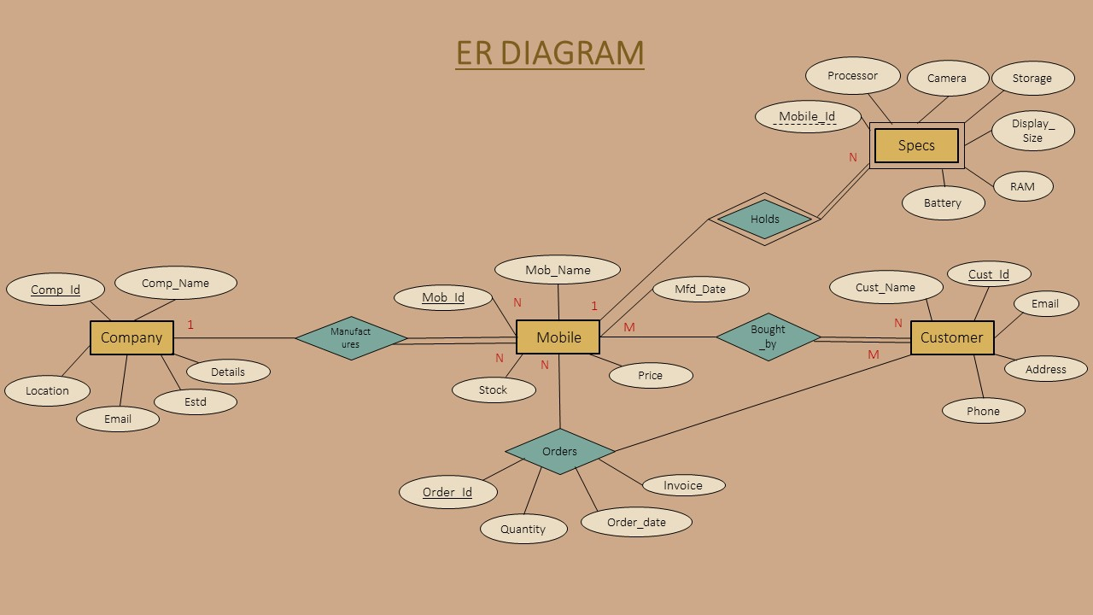
ER-Diagram

Slide 8
ER to Schema Mapping
Step 1: Mapping of regular entity types
Step 2: Mapping of weak entity types
Step 3: Mapping of binary 1:1 relationship types
Step 4: Mapping of binary 1: N relationship types
Step 5: Mapping of binary M:N relationship types
Step 6: Mapping of N-array relationship types

Slide 9
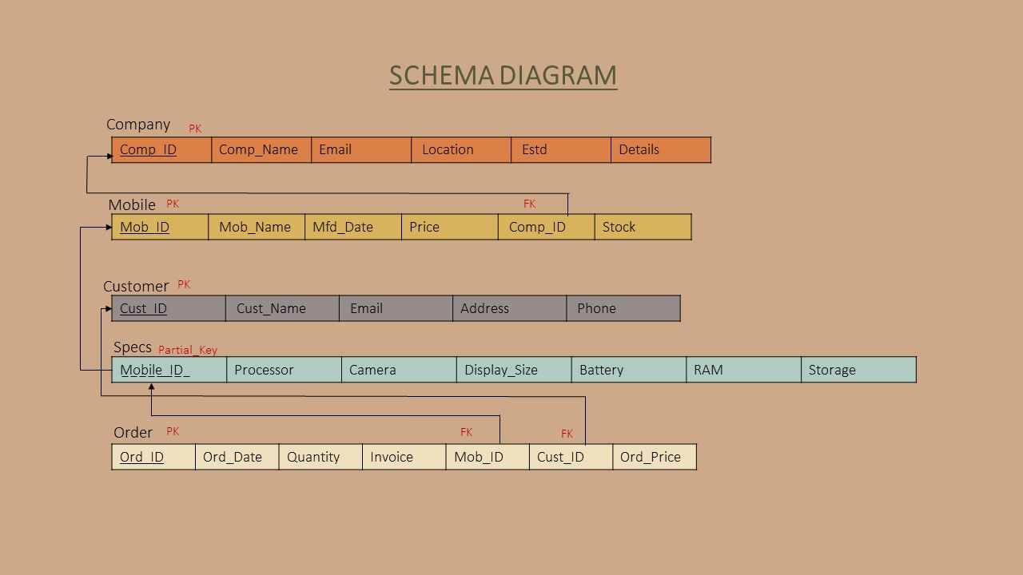
Schema Diagram

Slide 10
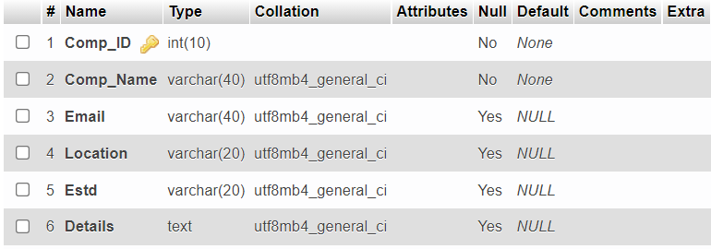
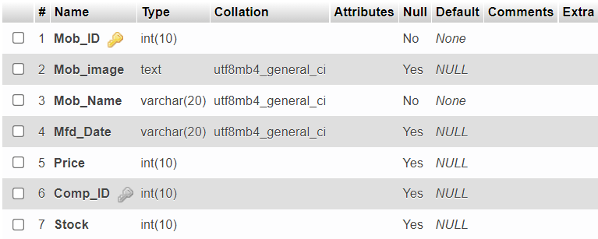
Tables description for SQL
COMPANY
MOBILE

Slide 11
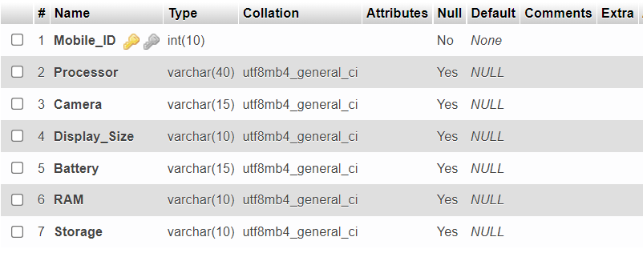
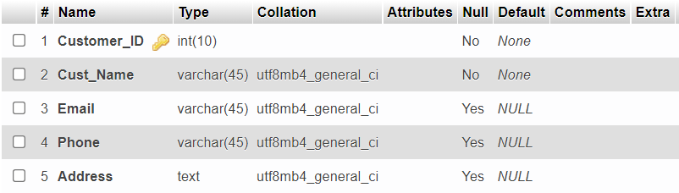
Tables description for SQL
SPECS
SPECS
CUSTOMER

Slide 12
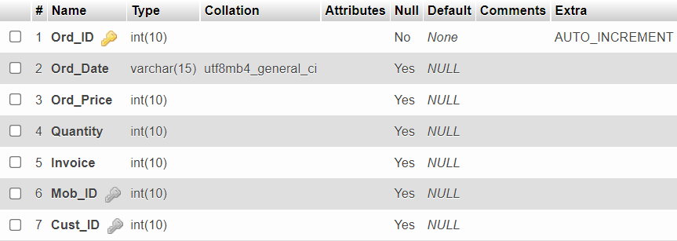
Tables description for SQL
ORDER

Slide 13
Tables description for MongoDB
USERS
NAME | TYPE
_id | Int32
username | string
email | string
password | string
COMPLAINT
NAME | TYPE
_id | Int32
Mob_ID | number
Cust_ID | number
Rating | number
Complaint Details (body) | string

Slide 14
Normalization of Tables
Normalization is the process of analyzing the given relation schema based on their functional dependencies and primary key to achieve desirable properties of minimizing redundancy and minimizing insert, delete, update anomaly.
1. First Normal Form (1NF) : The relations are said to be in 1NF if there are no multivalued attributes or nested relations.
This Mobile table holds atomic values for all this attributes.
Mob_ID | Mob_Name | Mfd_Date | Price | Stock | Comp_ID

Slide 15
Normalization of Tables
2.Second Normal Form (2NF) : The relations are said to be in 2NF if it is in 1NF and if every nonprime attribute is fully functionally dependent on primary key.
In this Mobile table all attributes are fully functionally dependent on primary key (Mob_ID).
Mob_ID | Mob_Name | Mfd_Date | Price | Stock | Comp_ID
3.Third Normal Form (3NF) : The relations are said to be in 3NF if it is 2NF and no non prime attribute is transitively dependent on primary key .
In this table there is no transitive dependency.
Mob_ID | Mob_Name | Mfd_Date | Price | Stock | Comp_ID

Slide 16

Stored Procedures
This procedure is used to get the total number of orders for a particular mobile and total quantity of the mobiles are ordered from the store. The name of the procedure is count_orders where is operates on the orders table.
This procedure takes one input parameter Mob_ID from the user.
CODE:
CREATE DEFINER=`root`@`localhost` PROCEDURE `count_orders` (IN `Mobile_ID` INT)
SELECT COUNT(Ord_ID) AS Total_Orders, SUM(Quantity) AS Total_Quantity
FROM orders WHERE Mob_ID = Mobile_ID$$
EXAMPLE:
To find the number of orders and total quantity for
a particular mobile which has Mob_ID = 1

Slide 17
Triggers
1) In this project a trigger is added to reduce the total stock of a mobile left after a mobile is ordered from the store.
CODE:
CREATE TRIGGER `stock_update_1`
AFTER INSERT ON `orders`
FOR EACH ROW
UPDATE mobile SET Stock=Stock-NEW.Quantity
WHERE mobile.Mob_ID=NEW.Mob_ID
The above trigger is called whenever an mobile is ordered from the store depending on the quantity of the order for a mobile and remaining stock is of the mobile is updated

Slide 18
Triggers
2) Another trigger is used which stops the insertion of order if the Quantity entered is more than the stock available.
CODE:
CREATE TRIGGER `stock_update_2`
BEFORE INSERT ON `orders` FOR EACH ROW
BEGIN
IF((SELECT mobile.Stock from mobile WHERE mobile.Mob_ID=NEW.Mob_ID)<NEW.Quantity) THEN
SIGNAL sqlstate '45001' set message_text = "Quantity is more than Stock !";
END if;
END
The above trigger is called whenever while entering the order details , if the Quantity entered is more than the available stock then it stops the insertion of that order.

Slide 19
Triggers
3) Another set of triggers is used in the project to maintain the LOGS of the insertion,updation and deletion of mobiles with the DATE and TIME of when the operation is done.
CODE:
For insert operation
CREATE TRIGGER `mobile_insert`
AFTER INSERT ON `mobile`
FOR EACH ROW
INSERT INTO trig VALUES(null,NEW.Mob_ID,NEW.Mob_name,NEW.Mfd_Date,NEW.Price,NEW.Comp_ID,NEW.Stock,'INSERTED',
CURRENT_DATE(),CURRENT_TIME())

Slide 20
Triggers
For update operation
CREATE TRIGGER `mobile_update`
AFTER UPDATE ON `mobile FOR EACH ROW
INSERT INTO trig VALUES(null,NEW.Mob_ID,NEW.Mob_name,NEW.Mfd_Date,NEW.Price,NEW.Comp_ID,NEW.Stock,
'UPDATED’, CURRENT_DATE(),CURRENT_TIME())
For Deletion operation
CREATE TRIGGER `mobile_delete`
BEFORE DELETE ON `mobile` FOR EACH ROW
INSERT INTO trig VALUES(null,OLD.Mob_ID,OLD.Mob_name,OLD.Mfd_Date,OLD.Price,OLD.Comp_ID,
OLD.Stock, 'DELETED’, CURRENT_DATE(),CURRENT_TIME())

Slide 21
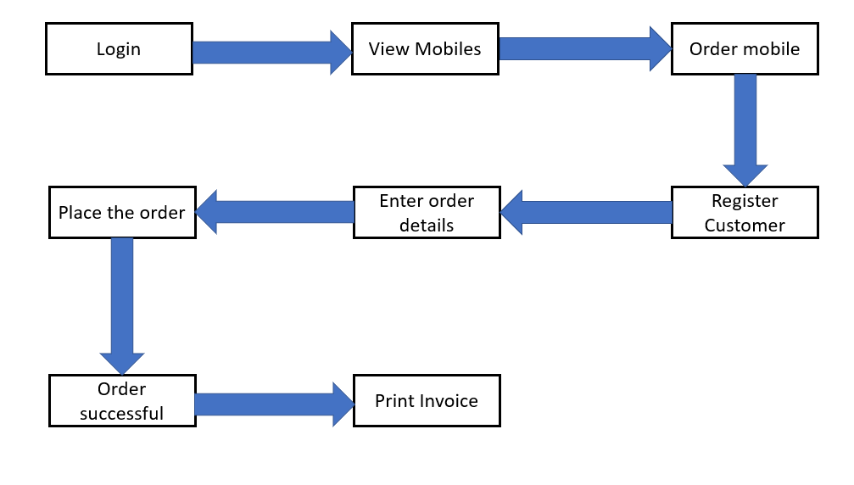
Data Flow Diagram

Slide 22
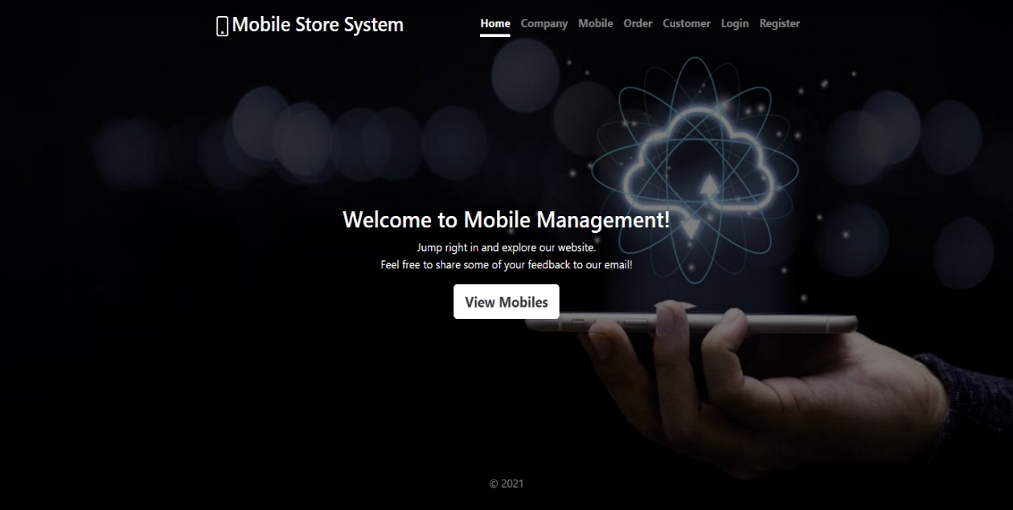
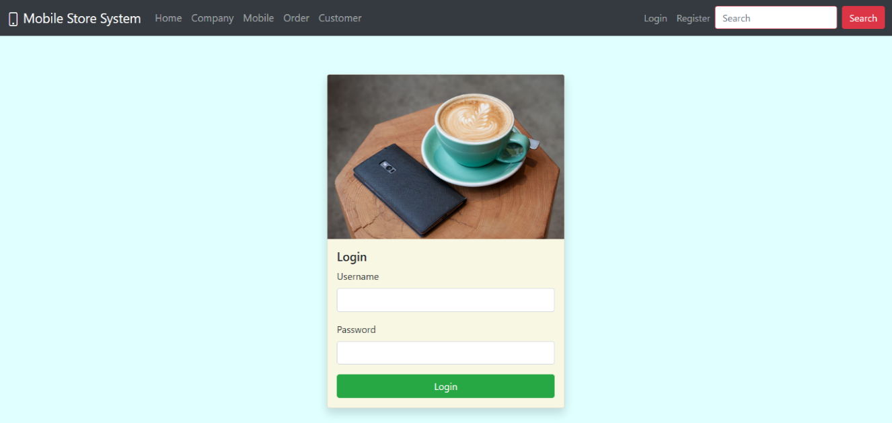
Results & Snapshots
Figure 1.0 Homepage
Figure 1.1 Login page
Figure 1.0 is the snapshot of the homepage with the navigation bar on top. If the store employee has already registered with the website, he can login using username which he used to register along with the valid password also which he set during registration.
Figure 1.1 is the login page using which the store employee can login into the website using his registered username and password.

Slide 23
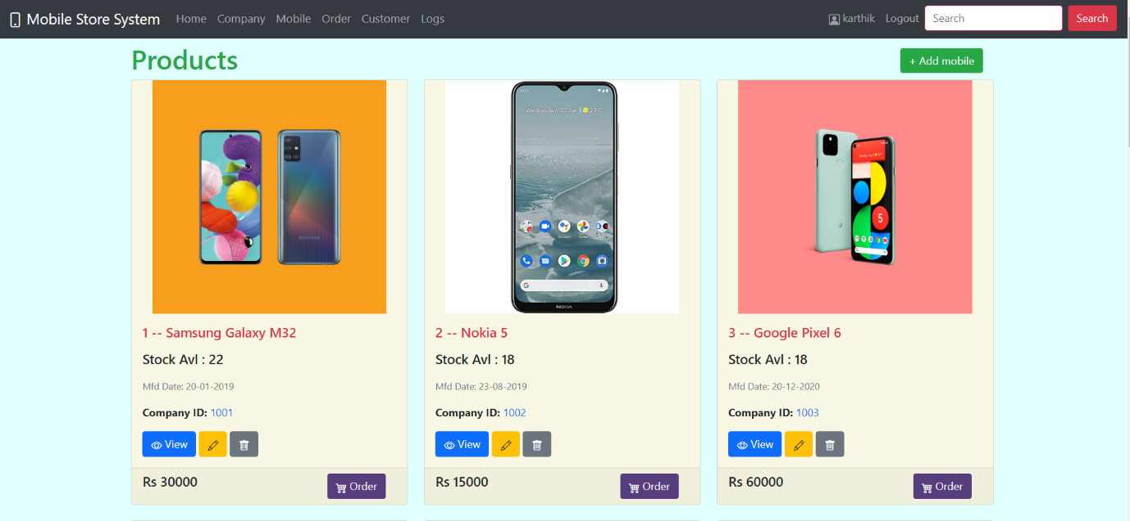
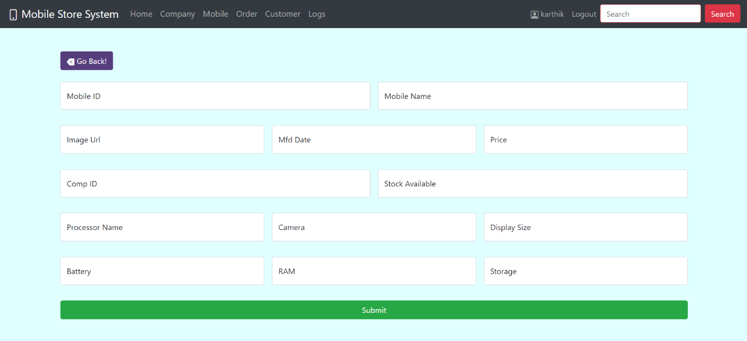
Results & Snapshots
Figure 1.2 All mobiles page
Figure 1.3 form to add mobile
Figure 1.2 shows the all the mobiles available in the store.It also shows the Mobile Name , price of the mobile its manufactured date and to which company the mobile belongs too.Using the displayed buttons the employee can view the mobile details , edit the
details , delete and order the mobile for a customer. Using the search button he can search a particular mobile.
Figure 1.3 is used to add a new mobile to a store.The store employee after logging in can add mobiles to his store.

Slide 24
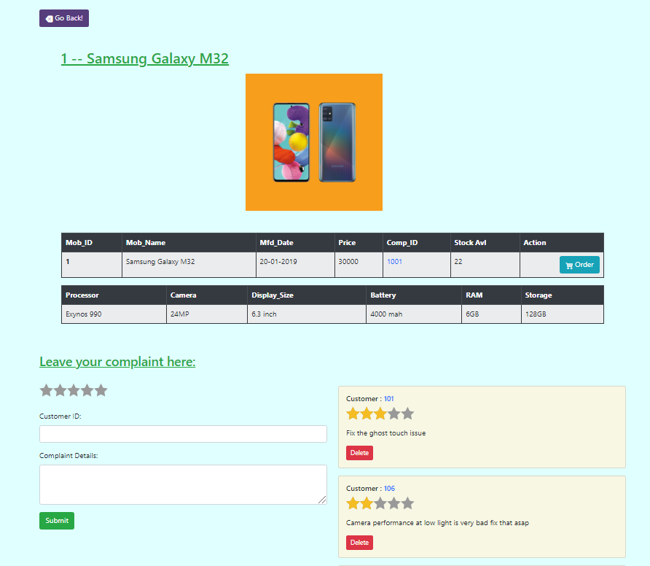
Results & Snapshots
Figure 1.4 shows the details of a particular mobile .
The employee of the store can take complaints from the customer using the form below the mobile details and can delete complaints as well.
Figure 1.4 view mobile

Slide 25
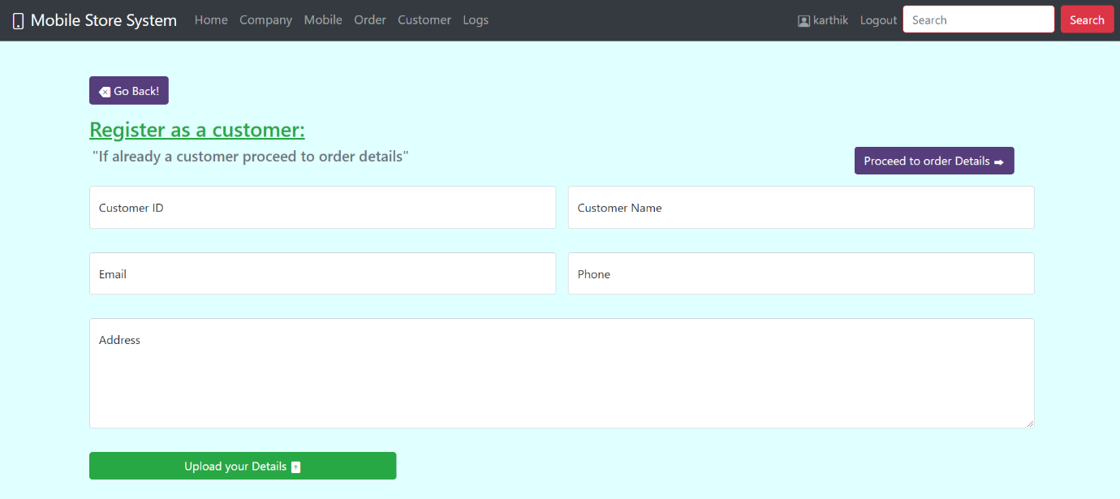
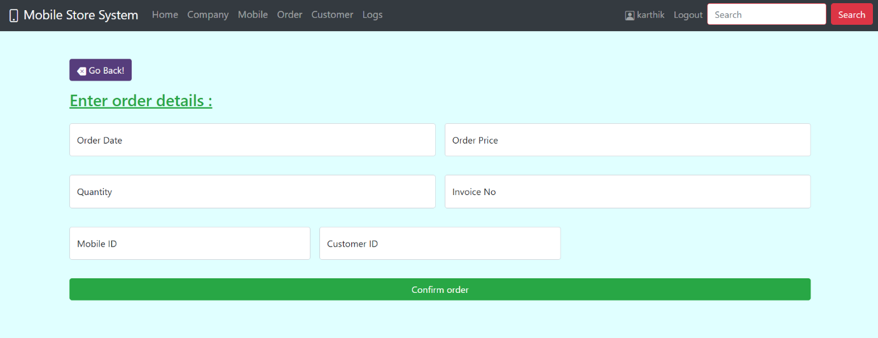
Results & Snapshots
Figure 1.6 order form
Figure 1.5 customer
Figure 1.5 shows the customer form where employee can register the customer details of the store .If the customer is a existing customer he can proceed to the order details.
Figure 1.6 shows the order form where the store employee can take the order details from the customer like which mobile , the quantity of the order and the customers ID

Slide 26
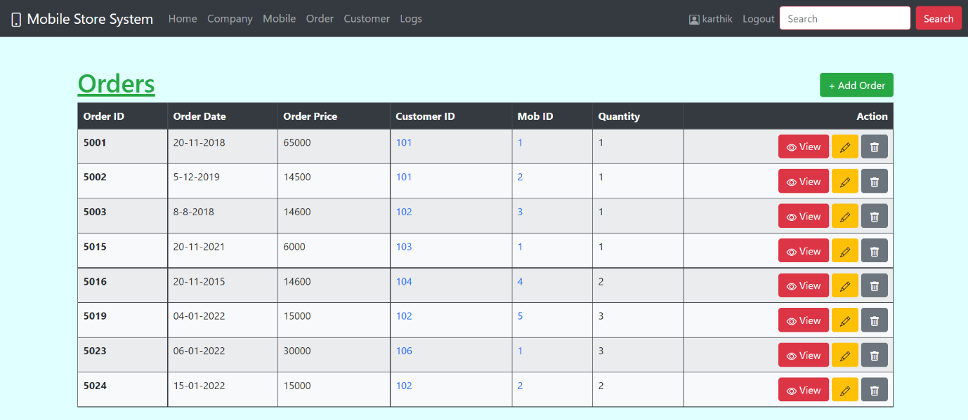
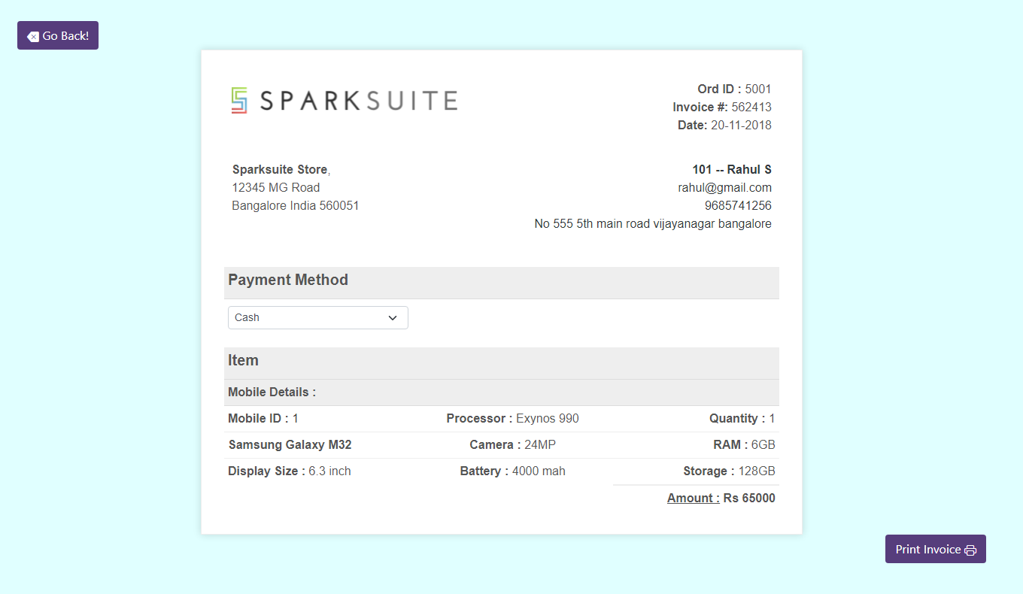
Results & Snapshots
Figure 1.7 order lists
Figure 1.8 order invoice
Figure 1.7 shows the list of orders for mobiles in the store .It displays the order details like order date, price, quantity etc… By clicking on the view button we can get the invoice of the particular order.The employee can edit the order details or even delete the order as well.
Once the payment is made from any of the payment method, the store employee can take the printout of the invoice receipt from the print button.

Slide 27
Applications
Major applications of Mobile Store Systems are:
All the mobiles and company details are maintained in the database.
Easy access to search mobile and order or view its details .
A database of all the orders are created for use if needed later.
The logs of updation, insertion of mobile details are maintained and invoice receipt for a order can be taken.

Slide 28
CONCLUSIONS
This project was an attempt to make the structure and working of an Mobile Store system simpler .
This is a working example similar to the real world implementation.
In this scenario, all the undertakings of the Mobile Store System was achieved in a constructive manner.
Given the right guidance and support, its applications and availability can be enhanced.

Slide 29
Future Enhancements
The project supports mobile store for single store , in the future this can be an addition to make the system to connect the databse to multiple stores.
Email and messages could be sent to the customer on successful ordering of the mobile.
Hosting it and developing further as e-commerce website.
Integrating and making order tracking facility when the website gets published as an e-commerce site.
Collecting and analyzing mobile prices and offering offers to the mobiles.

Slide 30
REFERENCES
Raghu Ramakrishnan and Johannes Gehrke, Database Management Systems, McGRAW HILL, 3rd Edition.
Ramez Elmasri and Shamkant B. Navathe, Fundamentals of Database Systems, Pearson, 7th Edition.
www.stackoverflow.com
www.mysql.com/doc
https://docs.microsoft.com
https://www.geeksforgeeks.org
https://www.rapidapi.org
https://docs.mongodb.com/manual/
https://nodejs.org/en/docs/
https://expressjs.com/en/5x/api.html

Slide 31
THANK YOU

